Slide 1
Fundamentals of
Hidden Markov Model (HMM)
Ren-yuan Lyu
Dept of Computer Science & Information Engineering,
Chang Gung University,
Guei-shan, Taoyuan, Taiwan
rylyu@mail.cgu.edu.tw
Reference:
X. Huang, “Spoken Language Processing”, Chap 8
L. Rabiner, “Fundamentals of Speech Recognition”, Chap 6
HTK Book, http://htk.eng.cam.ac.uk/

Slide 2
Hidden Markov Model (HMM)
A Hidden Markov Model is a (powerful) statistical model to describe very complex random processes (sequences) with time-varying characteristics by
  Building parametric models,
  Incorporating Dynamic Programming,
  Providing a unified scheme for pattern segmentation and pattern classification (recognition).

Slide 3
Applications of HMM
Automatic Speech Recognition
Statistical Language Modeling
Machine Translation
Bioinformatics
…..
…..

Slide 4
Definition of HMM
A HMM can be viewed as a doubly embedded random process with a “hidden” random process, usually called the state process S(t), which is not directly observable.
The observable random process O(t) in a HMM is probabilistically associated with the hidden random process S(t).
S(t) is assumed a (1st order) Markov chain, and O(t) is assumed dependent only on the value of S(t) at the same time index t.

Slide 5
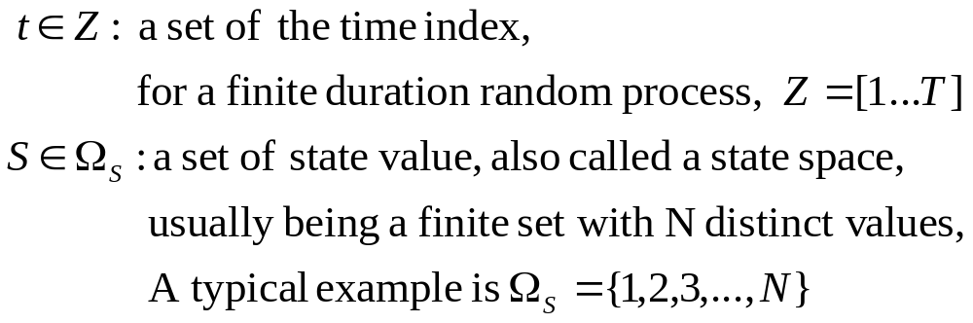
Specification of HMM
The State sequence (process), S(t),
  with the state space Ω_{S}

Slide 6
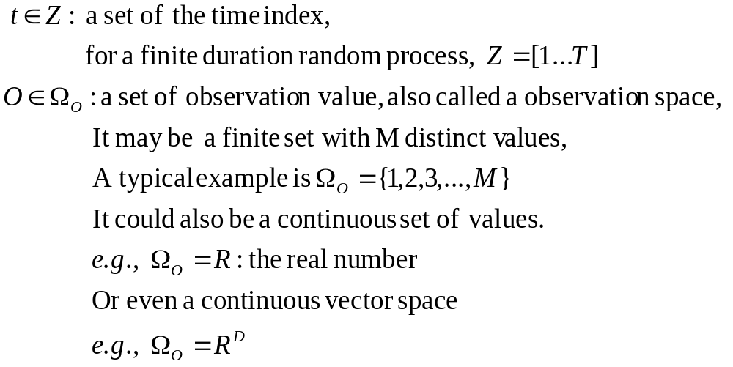
The Observation sequence, O(t),
  with the observation space Ω_{O}

Slide 7
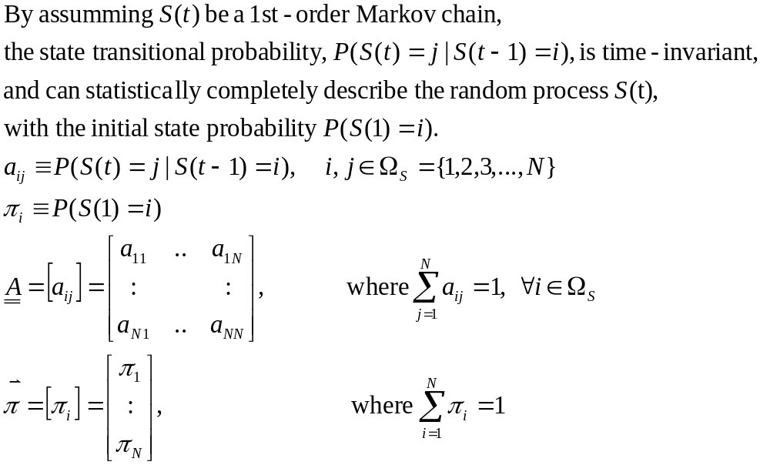
The state transitional probability distribution A=[a_{ij}], and initial state probability distribution π=[π_{i}]

Slide 8
The state diagram
a₁₁
a_{NN}
1
N
a_{1N}
a_{N1}
π₁
π_{N}
0

Slide 9
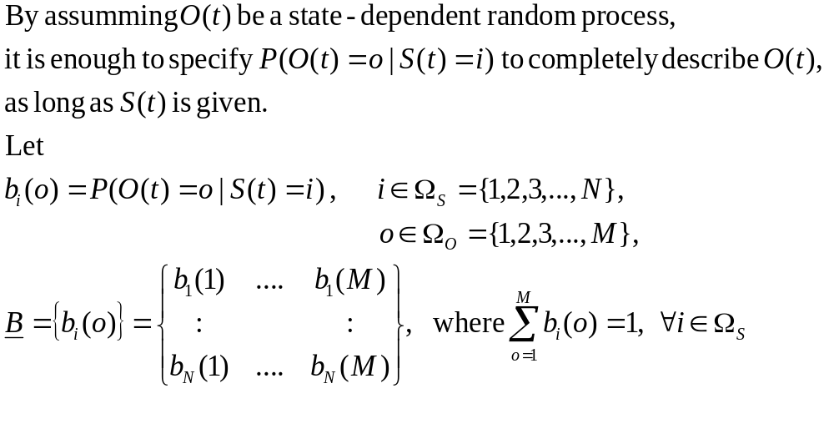
The (state-dependent) observation probability distribution, B= {b_{i}(o)}

Slide 10
The state-dependent observation distributions
b₁(o)
1
a₁₁
o
π₁
1
M
a_{1N}
a_{N1}
π_{N}
b_{N}(o)
N
a_{NN}
o
1
M

Slide 11
Hidden Markov Machine
To put all the elements of HMM together, we design a Hidden Markov Machine as follows:
    There is a state sequence generator, which generates random sequence S(t) under the control of HMM parameters {π, A}.
    There are N state-dependent observation generators, each of which generates observation sequence under the control of HMM parameter B={b_{i}(o)}
    The state value s_{t}, generated by the state sequence generator at time t, determines which observation generator’s output, o^{(i)}_{t} , will be used as the output observation o_{t} at time t.

Slide 12

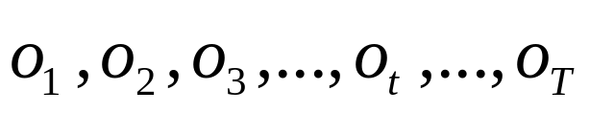


Hidden Markov Machine
State-dependent
Output observation probability
b₁(o)
o
1
M
State transition probability
Initial state probability
State 1
Observation Generator
1
π₁
a₁₁
State Sequence
Generator
a_{N1}
a_{1N}
π_{N}
N
a_{NN}
State N
Observation Generator
b_{N}(o)
o
1
M
State-dependent
Output observation probability

Slide 13
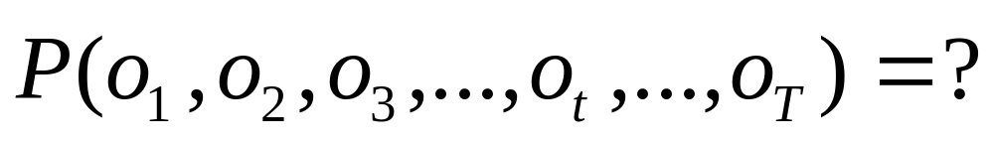
3 Basic Problems of HMM
The Evaluation Problem
The Estimation (Learning) Problem
The Decoding Problem

Slide 14
The Evaluation Problem of HMM
Given a HMM, with parameters {π, A, B},

Slide 15
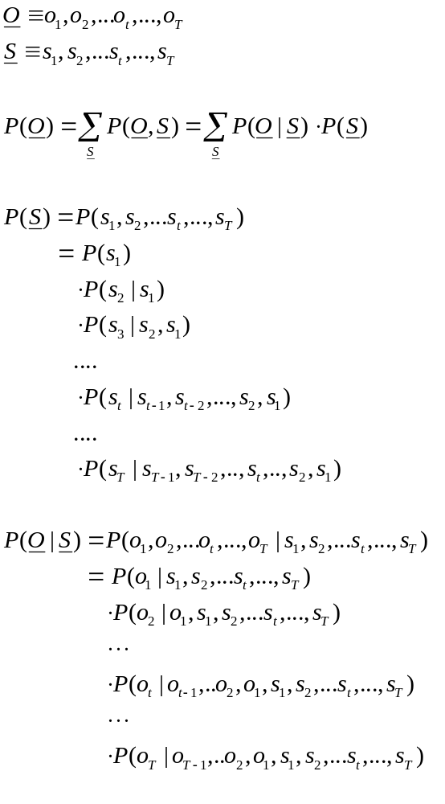
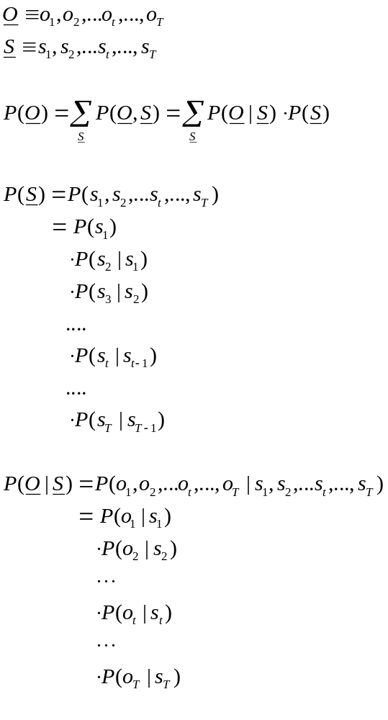
Markov Assumption
1. The current state depends only on the previous state
2. The observation depends only on the current state
1
Markov Assumption
2

Slide 16
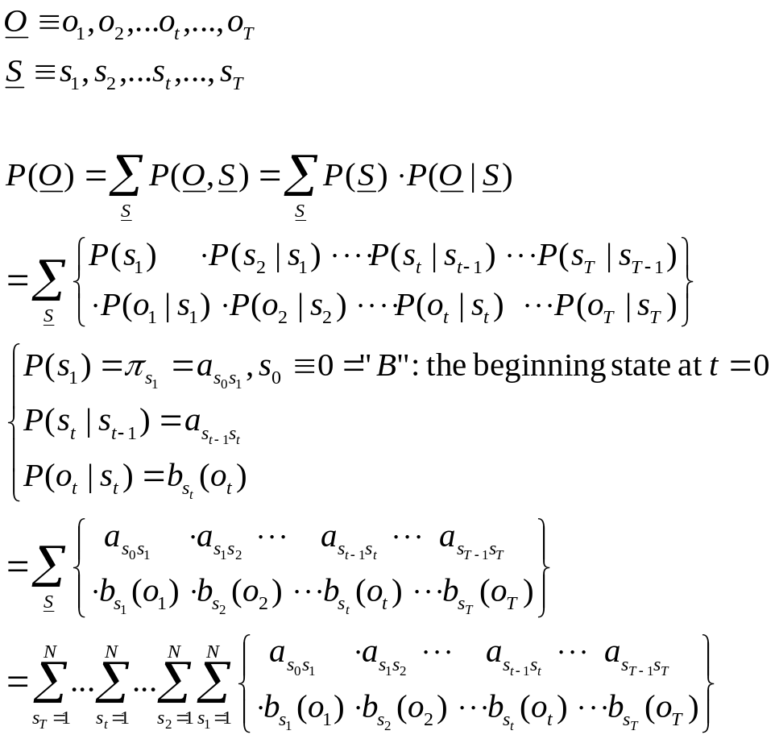
Direct computation of P(O)
Totally, there are N^{T} possible sequences for S,
i.e., N^{T} terms of { .. } need to be calculated.

Slide 17




Forward/Backward Algorithm
The forward algorithm

Slide 18
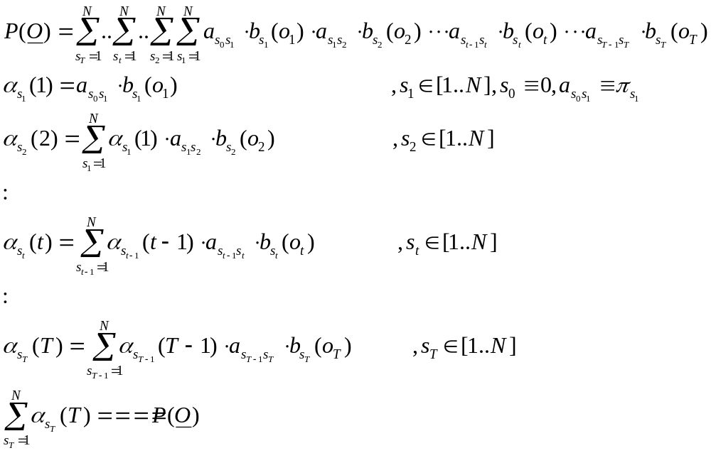
The computation complexity reduces to be T.N²

Slide 19
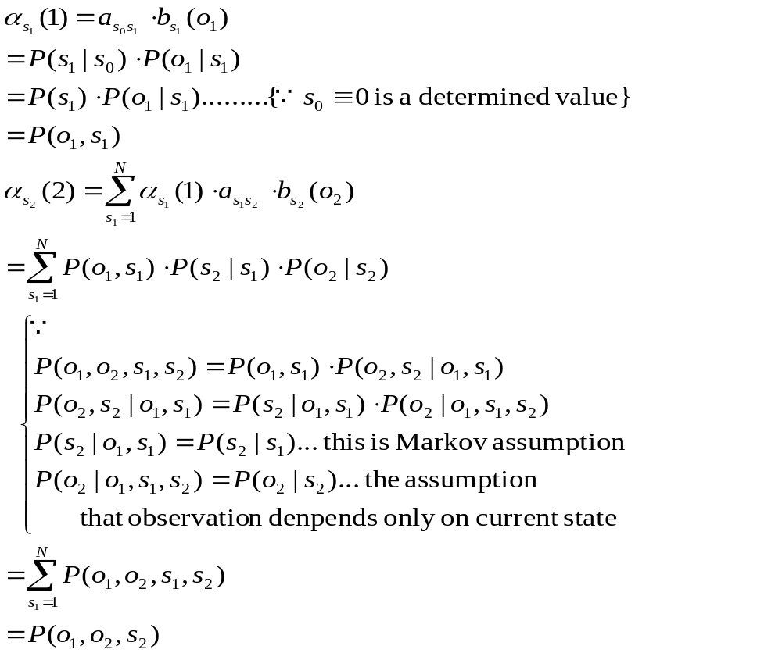
The meaning of the forward probability

Slide 20
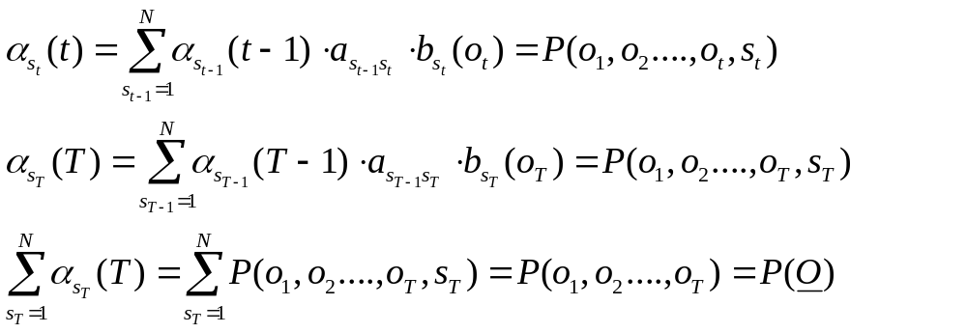

Slide 21
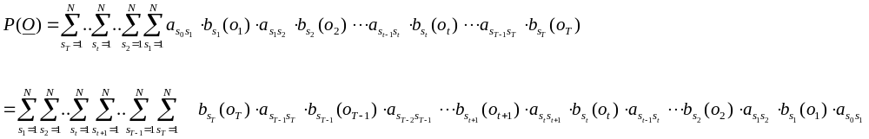






The backward algorithm

Slide 22
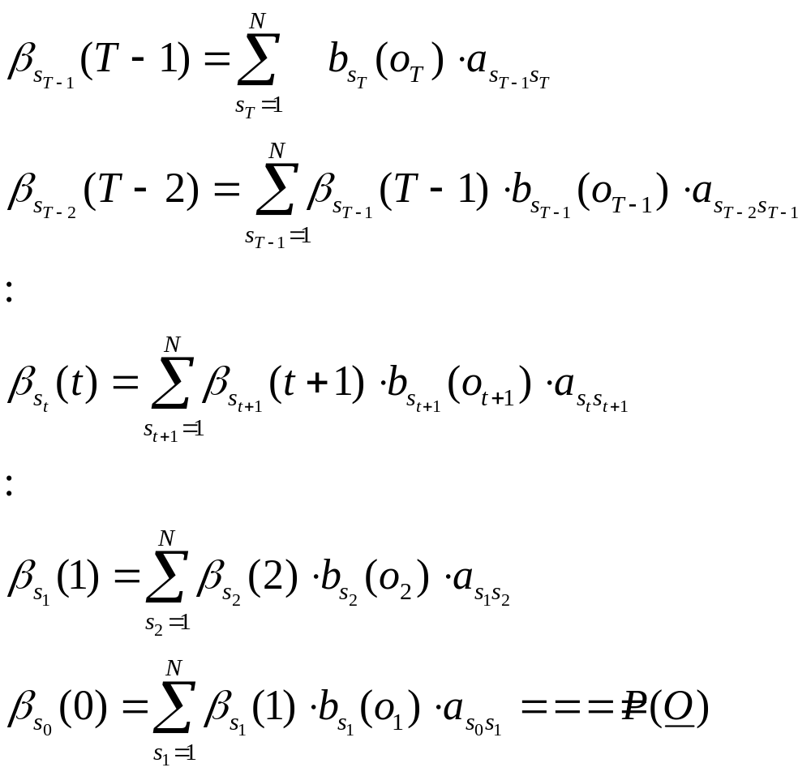

Slide 23
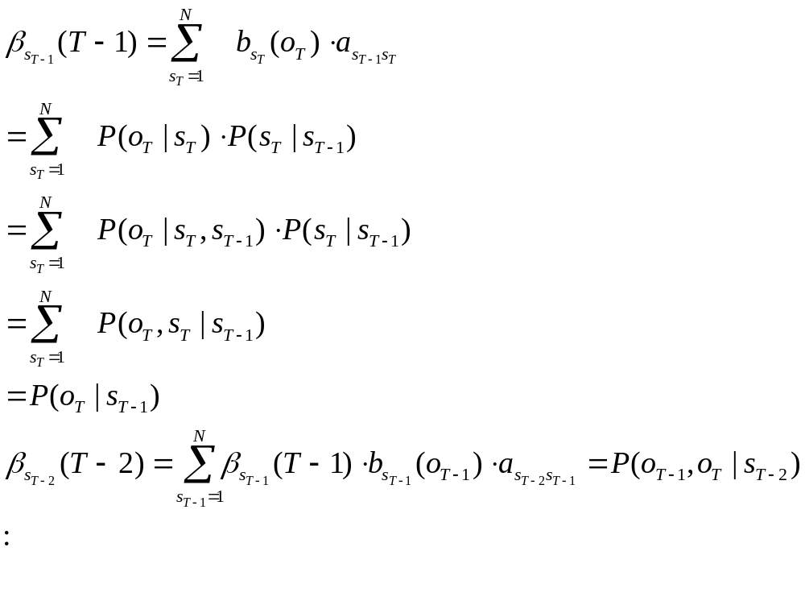
The meaning of the backward probability

Slide 24
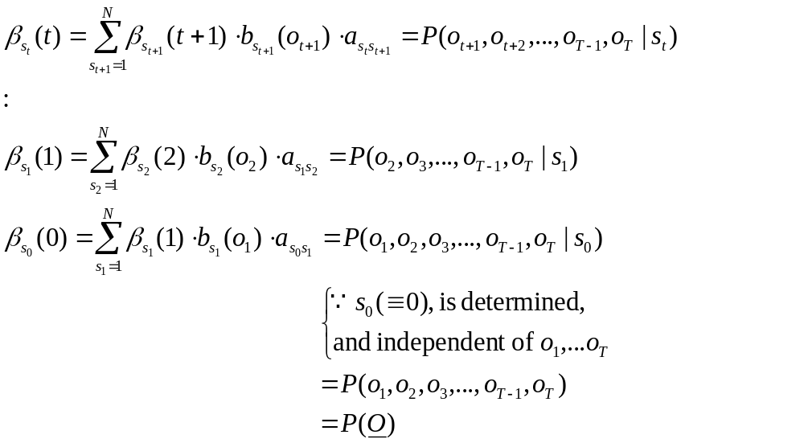

Slide 25
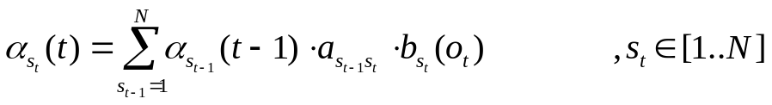
Trellis view of the forward algorithm
o₁
o₂
o_{t-1}
o_{t}
o_{T-1}
o_{T}
….
….
t
0
1
2
t-1
t
T-1
T
a_{0N}
0
0
a₀₁
α₀(0)=1
a₀₁
o
a_{0N}
a₁₁
M
a₁₁
State 1
a₁₁
a₁₁
1
b₁(o₁)
b₁(o₂)
b₁(o_{t-1})
b₁(o_{t})
b₁(o_{T-1})
b₁(o_{T})
b₁(o)
1
α₁(1)
a_{1N}
α₁(2)
α₁(t-1)
a_{1N}
α₁(t)
α₁(T-1)
a_{1N}
α₁(T)
a_{1N}
a_{N1}
o
a_{N1}
a_{N1}
a_{N1}
a_{NN}
M
State
N
a_{NN}
N
b_{N}(o₁)
a_{NN}
b_{N}(o₂)
b_{N}(o_{t-1})
b_{N}(o_{t})
b_{N}(o_{T-1})
a_{NN}
b_{N}(o_{T})
b_{N}(o)
1
α_{N}(1)
α_{N}(2)
α_{N}(t-1)
α_{N}(t)
α_{N}(T-1)
α_{N}(T)
P(O)
i
s₁
s₂
s_{t-1}
s_{t}
s_{T-1}
s_{T}

Slide 26

Trellis view of the backward algorithm
o₁
o₂
o_{t-1}
o_{t}
o_{T-1}
o_{T}
….
….
t
0
1
2
t-1
t
T-1
T
a_{0N}
0
0
a₀₁
β₀(0)=P(O)
a₀₁
o
a_{0N}
a₁₁
M
a₁₁
a₁₁
State 1
a₁₁
1
b₁(o₁)
b₁(o₂)
b₁(o_{t})
b₁(o_{t+1})
b₁(o_{T-1})
b₁(o_{T})
b₁(o)
1
β₁(1)
a_{1N}
β₁(2)
β₁(t)
a_{1N}
β₁(t+1)
β₁(T-1)
a_{1N}
β₁(T)=1
a_{1N}
a_{N1}
o
a_{N1}
a_{N1}
a_{N1}
a_{1(N+1)}=1
a_{NN}
M
State
N
N
b_{N}(o₁)
a_{NN}
b_{N}(o₂)
b_{N}(o_{t})
a_{NN}
b_{N}(o_{t+1})
b_{N}(o_{T-1})
a_{NN}
b_{N}(o_{T})
a_{N(N+1)}=1
b_{N}(o)
1
β_{N}(1)
β_{N}(2)
β_{N}(t)
β_{N}(t+1)
β_{N}(T-1)
β_{N}(T)=1
i
s₁
s₂
s_{T}
β_{N+1}(T+1)=1
s_{t-1}
s_{t}
s_{T-1}

Slide 27
The Estimation (Learning) Problem of HMM
Given a HMM, with parameters {π, A, B}, and observation sequence(s)
How can we find “better” or even the “best” or “most likely”
(new) parameters {π∗, A*, B*},
to help the HMMachine generate such an observation sequence
with larger or even the maximal probability?
This problem can be reformulate as follows:

Slide 28
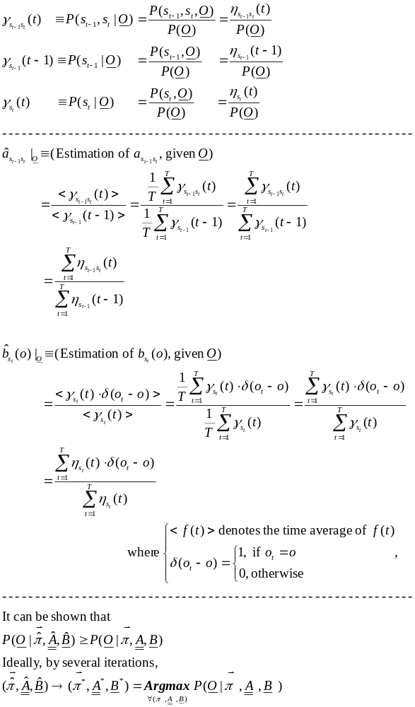
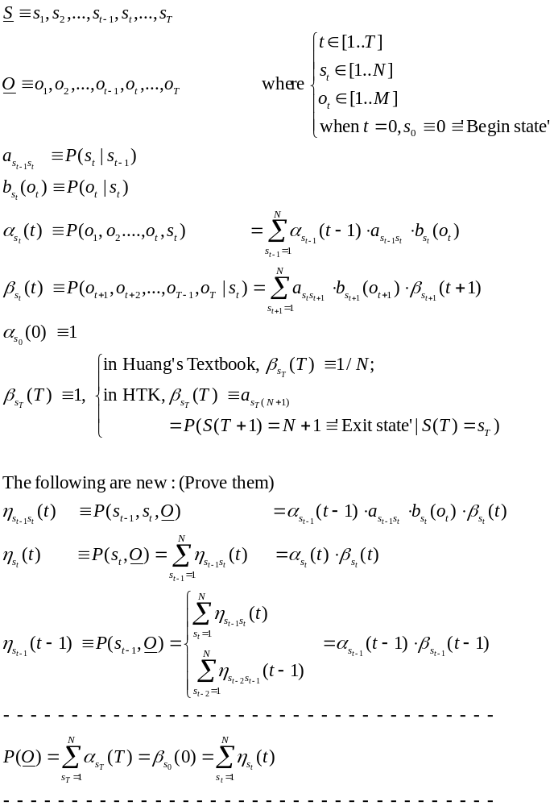
The solution to the HMM Learning problem

Slide 29
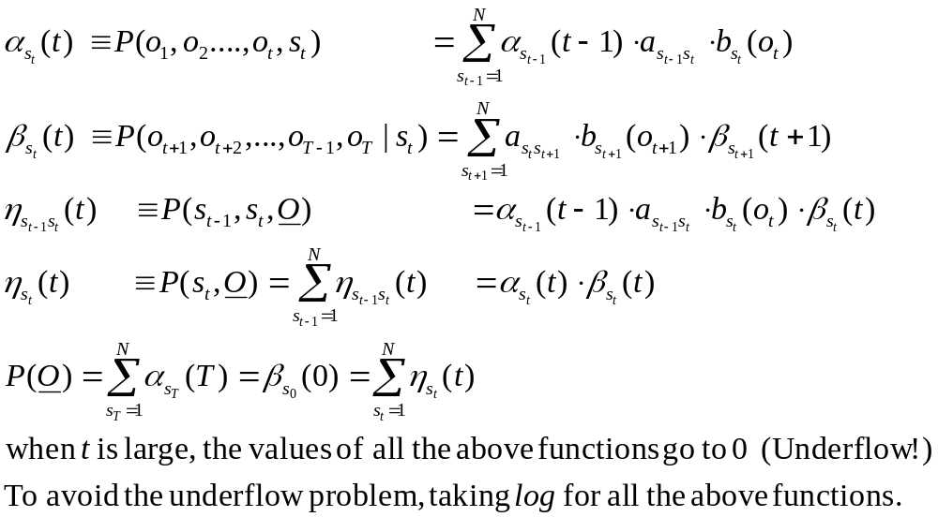
Underflow problem of
Kernel computing in HMM

Slide 30
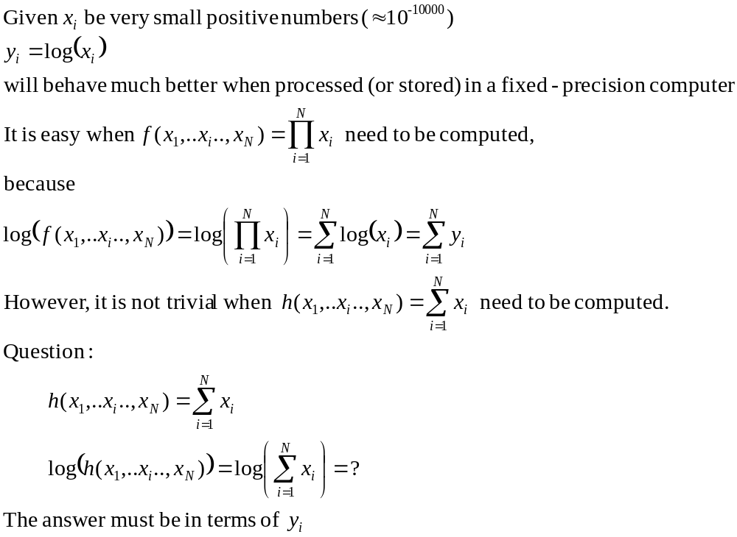
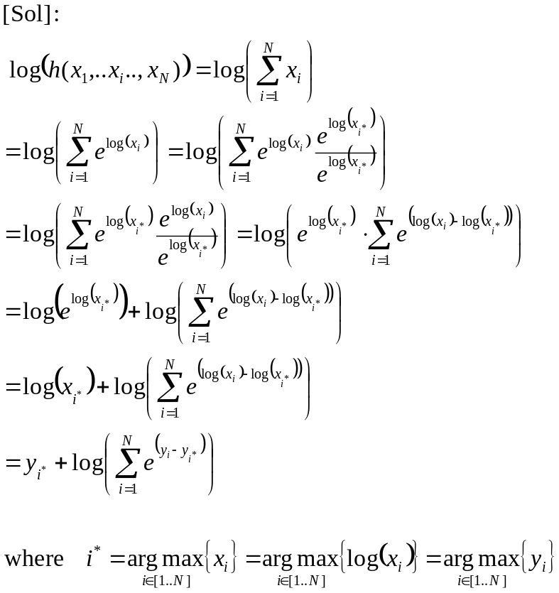
Log Summation

Slide 31
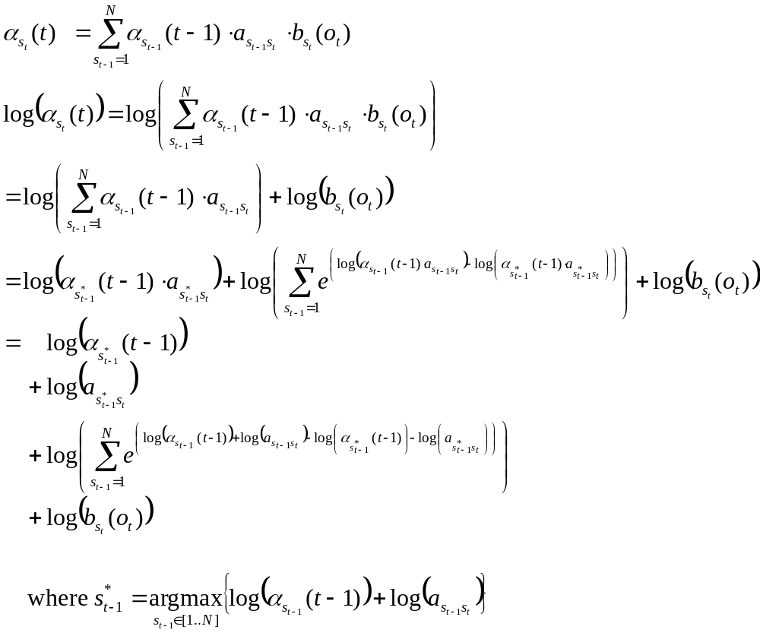

Slide 32
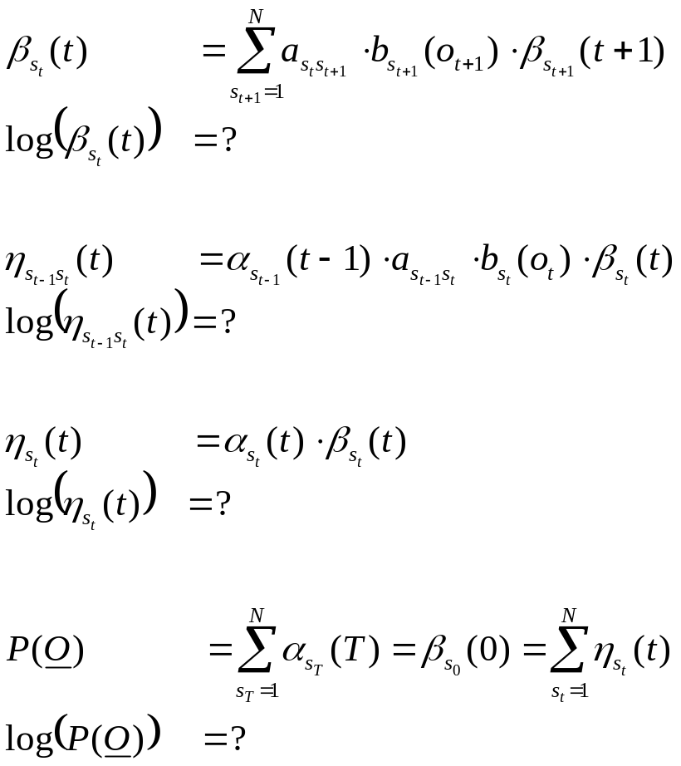
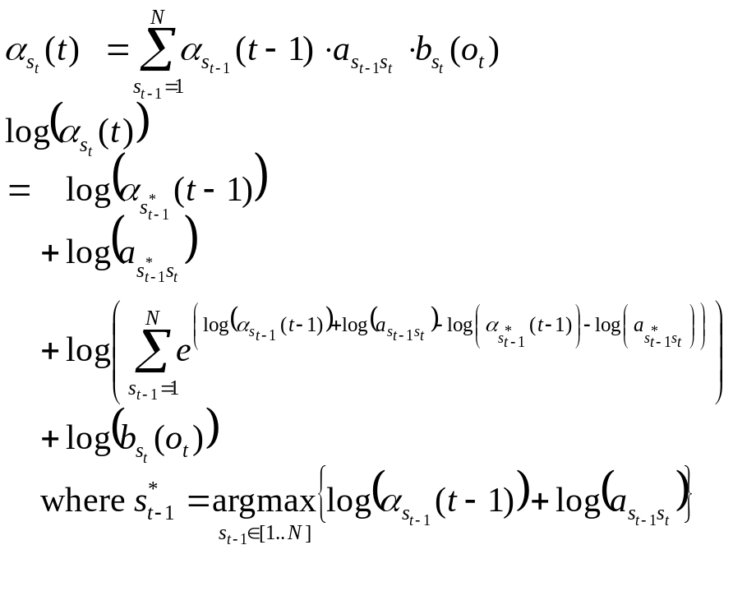
Log version of
Kernel computing in HMM

Slide 33
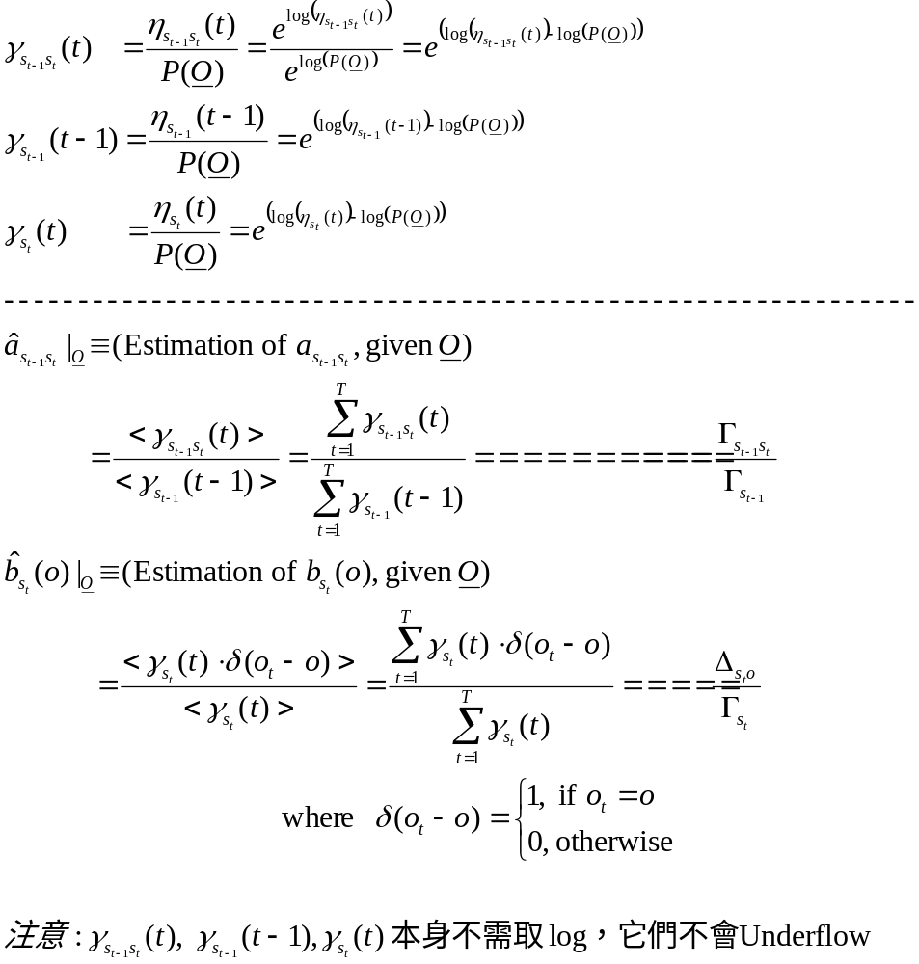

Slide 34
o₁
o₂
o_{t-1}
o_{t}
o_{T-1}
o_{T}
….
….
t
0
1
2
t-1
t
T-1
T
a_{0N}
0
0
α₀(0)
a₀₁
β₀(0)
γ₀(0)
γ₀₁(1)
o
γ_{0N}(1)
a₁₁
M
γ₁₁(2)
γ₁₁(t)
γ₁₁(T)
State 1
1
b₁(o₁)
b₁(o₂)
b₁(o_{t-1})
b₁(o_{t})
b₁(o_{T-1})
b₁(o_{T})
b₁(o)
γ_{1N}(2)
γ_{1N}(t)
γ_{1N}(T)
1
α₁(1)
α₁(2)
α₁(t-1)
α₁(t)
α₁(T-1)
α₁(T)
β₁(1)
β₁(2)
β₁(t-1)
β₁(t)
β₁(T-1)
β₁(T)
a_{1N}
a_{N1}
γ₁(1)
γ₁(2)
γ₁(t-1)
γ₁(t)
γ₁(T-1)
γ₁(T)
a_{NN}
o
γ_{N1}(2)
γ_{N1}(t)
γ_{N1}(T)
State
N
M
N
b_{N}(o₁)
γ_{NN}(2)
b_{N}(o₂)
b_{N}(o_{t-1})
γ_{NN}(t)
b_{N}(o_{t})
b_{N}(o_{T-1})
γ_{NN}(T)
b_{N}(o_{T})
b_{N}(o)
1
α_{N}(1)
α_{N}(2)
α_{N}(t-1)
α_{N}(t)
α_{N}(T-1)
α_{N}(T)
β_{N}(1)
β_{N}(2)
β_{N}(t-1)
β_{N}(t)
β_{N}(T-1)
β_{N}(T)
γ_{N}(1)
γ_{N}(2)
γ_{N}(t-1)
γ_{N}(t)
γ_{N}(T-1)
γ_{N}(T)
i
s₁
s₂
s_{t-1}
s_{t}
s_{T-1}
s_{T}
P(O)

Slide 35
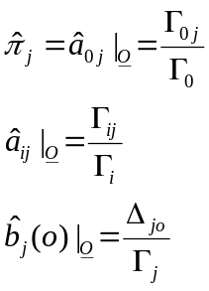
Γ_{i}
Σ
Σ
γ_{i}(1)
γ_{i}(2)
γ_{i}(t-1)
γ_{i}(t)
γ_{i}(T-1)
γ_{i}(T)
Γ_{ij}
γ_{ij}(1)
γ_{ij}(2)
γ_{ij}(t-1)
γ_{ij}(t)
γ_{ij}(T-1)
γ_{ij}(T)
Δ_{jo}
Σ
γ_{j}(1) . δ(o₁-o)
γ_{j}(2) . δ(o₂-o)
γ_{j}(t-1) . δ(o_{t-1}-o)
γ_{j}(t) . δ(o_{t}-o)
γ_{j}(T-1) . δ(o_{T-1}-o)
γ_{j}(T) . δ(o_{t}-o)
o₁
o₂
o_{t-1}
o_{t}
o_{T-1}
o_{T}
….
….
t
0
1
2
t-1
t
T-1
T
a_{0N}
0
0
a₀₁
γ₀(0)
o
M
Δ_{1M}
γ₀₁(1)
o
γ_{0N}(1)
Γ₀₁
Γ₁
:
a₁₁
M
Γ_{0N}
Γ₁₁
State 1
γ₁₁(2)
γ₁₁(t)
γ₁₁(T)
1
b₁(o)
γ_{1N}(2)
γ_{1N}(t)
γ_{1N}(T)
1
Δ₁₁
b₁(o)
1
γ₁(1)
γ₁(2)
γ₁(t-1)
γ₁(t)
γ₁(T-1)
Γ_{1N}
γ₁(T)
o
a_{1N}
a_{N1}
Γ_{N1}
M
Δ_{NM}
a_{NN}
o
Γ_{N}
γ_{N1}(2)
γ_{N1}(t)
γ_{N1}(T)
State
N
M
:
N
γ_{NN}(2)
γ_{NN}(t)
γ_{NN}(T)
Γ_{NN}
b_{N}(o)
1
γ_{N}(1)
γ_{N}(2)
γ_{N}(t-1)
γ_{N}(t)
γ_{N}(T-1)
γ_{N}(T)
b_{N}(o)
1
Δ_{N1}
i
s₁
s₂
s_{t-1}
s_{t}
s_{T-1}
s_{T}

Slide 36
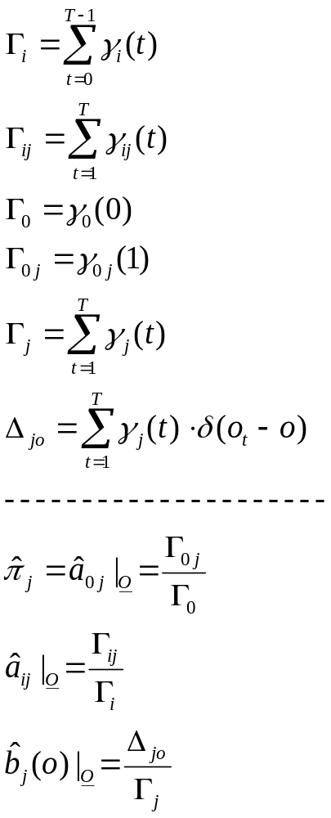
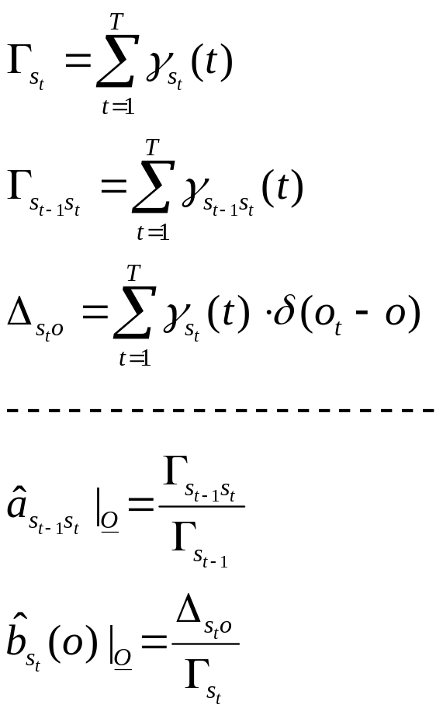
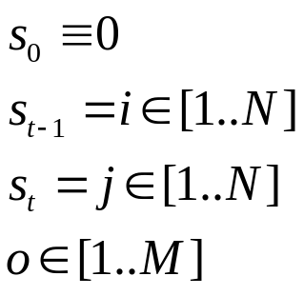

Slide 37
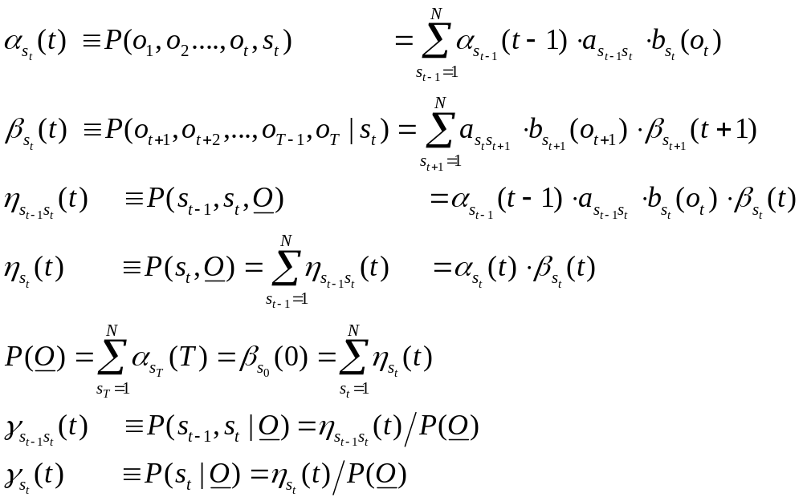
Some interpretations about α,β,η,γ

Slide 38
P(O)
代表所有
從(i=0, t=0)到(i=N+1, t=T+1)所有的路徑，
如圖所示總共有N^{T}條
o₁
o₂
o_{t-1}
o_{t}
o_{T-1}
o_{T}
….
….
t
0
1
2
t-1
t
T-1
T
a_{0N}
0
0
a₀₁
o
a₁₁
M
State 1
1
b₁(o)
1
a_{1N}
a_{N1}
a_{NN}
o
State
N
M
N
b_{N}(o)
1
P(O)
i
s₁
s₂
s_{t-1}
s_{t}
s_{T-1}
s_{T}

Slide 39
α_{i}(t)
代表所有
從(i=0,t=0)到(i, t)所有的路徑，
如圖所示總共有N^{t-1}條
o₁
o₂
o_{t-1}
o_{t}
o_{T-1}
o_{T}
a_{0N}
0
1
2
….
t-1
t
….
T-1
T
t
0
0
a₀₁
o
α₁(t)
a₁₁
M
State 1
b₁(o)
1
1
a_{1N}
a_{N1}
o
a_{NN}
M
State
N
b_{N}(o)
N
1
P(O)
i
s₁
s₂
s_{t-1}
s_{t}
s_{T-1}
s_{T}
o₁
o₂
o_{t-1}
o_{t}
o_{T-1}
o_{T}
a_{0N}
0
1
2
….
t-1
t
….
T-1
T
t
0
0
a₀₁
o
a₁₁
M
State 1
b₁(o)
1
1
a_{1N}
a_{N1}
o
a_{NN}
M
α_{N}(t)
State
N
b_{N}(o)
N
1
P(O)
i
s₁
s₂
s_{t-1}
s_{t}
s_{T-1}
s_{T}

Slide 40
代表所有
從(i,t)到(i=N+1,t=T+1)所有的路徑，
如圖所示總共有N^{T-t}條
β_{i}(t)
o₁
o₂
o_{t-1}
o_{t}
o_{t+1}
o_{T}
a_{0N}
0
1
2
….
t-1
t
….
T-1
T
t
0
0
a₀₁
o
β₁(t)
a₁₁
M
State 1
b₁(o)
1
1
a_{1N}
a_{N1}
o
a_{NN}
M
State
N
b_{N}(o)
N
1
P(O)
i
s₁
s₂
s_{t-1}
s_{t}
s_{T-1}
s_{T}
o₁
o₂
o_{t-1}
o_{t}
o_{t+1}
o_{T}
a_{0N}
0
1
2
….
t-1
t
….
T-1
T
t
0
0
a₀₁
o
a₁₁
M
State 1
b₁(o)
1
1
a_{1N}
a_{N1}
o
a_{NN}
M
State
N
b_{N}(o)
N
β_{N}(t)
1
P(O)
i
s₁
s₂
s_{t-1}
s_{t}
s_{T-1}
s_{T}

Slide 41
γ_{i}(t)
η_{i}(t)
o₁
o₂
o_{t-1}
o_{t}
o_{t+1}
o_{T}
a_{0N}
0
1
2
….
t-1
t
….
T-1
T
t
0
0
a₀₁
o
η₁(t)
a₁₁
M
State 1
b₁(o)
1
1
a_{1N}
a_{N1}
o
a_{NN}
M
State
N
b_{N}(o)
N
1
P(O)
i
s₁
s₂
s_{t-1}
s_{t}
s_{T-1}
s_{T}
o₁
o₂
o_{t-1}
o_{t}
o_{t+1}
o_{T}
a_{0N}
0
1
2
….
t-1
t
….
T-1
T
t
0
0
a₀₁
o
a₁₁
M
State 1
b₁(o)
1
1
a_{1N}
a_{N1}
o
a_{NN}
M
η_{N}(t)
State
N
b_{N}(o)
N
1
P(O)
i
s₁
s₂
s_{t-1}
s_{t}
s_{T-1}
s_{T}
代表所有
從(i=0,t=0)到(I,t)
再從(i,t)到(i=N+1, t=T+1 )的
所有的路徑，如圖所示總共有N^{T-1}條
這些路徑的共同特色為： 它們都經過(t,i)

Slide 42
η_{ij}(t),
γ_{ij}(t)
o₁
o₂
o_{t-1}
o_{t}
o_{t+1}
o_{T}
a_{0N}
0
0
0
1
2
….
t-1
t
….
T-1
T
t
a₀₁
o
η₁₁(t)
a₁₁
b₁(o)
M
State 1
1
1
a_{1N}
a_{N1}
o
a_{NN}
b_{N}(o)
M
State
N
1
N
s₁
s₂
s_{t-1}
s_{T-1}
s_{T}
P(O)
i
s_{t}
o₁
o₂
o_{t-1}
o_{t}
o_{t+1}
o_{T}
a_{0N}
0
0
0
1
2
….
t-1
t
….
T-1
T
t
a₀₁
o
a₁₁
b₁(o)
M
State 1
1
1
η₁₂(t)
a_{1N}
a_{N1}
o
a_{NN}
b_{N}(o)
M
State
N
1
N
s₁
s₂
s_{t-1}
s_{T-1}
s_{T}
P(O)
i
o₂
s_{t}
o₁
o_{t-1}
o_{t}
o_{t+1}
o_{T}
a_{0N}
0
0
0
1
2
….
t-1
t
….
T-1
T
t
a₀₁
o
a₁₁
b₁(o)
M
State 1
1
1
η_{N1}(t)
a_{1N}
a_{N1}
o
a_{NN}
b_{N}(o)
M
State
N
1
N
s₁
s₂
s_{t-1}
s_{T-1}
s_{T}
P(O)
i
o₂
s_{t}
o₁
o_{t-1}
o_{t}
o_{t+1}
o_{T}
a_{0N}
0
0
0
1
2
….
t-1
t
….
T-1
T
t
a₀₁
o
a₁₁
b₁(o)
M
State 1
1
1
a_{1N}
a_{N1}
o
η_{NN}(t)
a_{NN}
b_{N}(o)
M
State
N
1
N
s₁
s₂
s_{t-1}
s_{T-1}
s_{T}
P(O)
i
s_{t}

Slide 43
Training Formula & Interpretations
走完全程後，(state=i)會出現的次數
走完全程後，(state=i)且(next state=j)會出現的次數
走完全程後，一開始(t=0時）(state=0)會出現的次數
走完全程後，一開始(t=0時）(state=0)且(next state=j) 會出現的次數
走完全程後，(state=j)會出現的次數
走完全程後，(state=j)且(observation=o) 會出現的次數

Slide 44
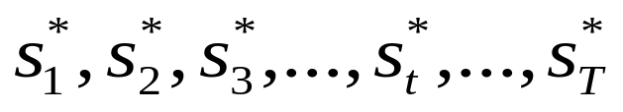
The Decoding Problem of HMM
Given a HMM, with parameters {π, A, B}, and an observation sequence
What is the “best” or “most likely” state sequence
to help the HMMachine generate such an observation sequence?
This problem can be reformulate as follows:

Slide 45
Optimal principle: (The Dynamic Programming Principle)
If path S* is the “optimal” path of all paths from A=(0,0) to B=(N+1,T+1), which passes C=(i, t),
Then the partial path S’ (= S*[0..t]) of S* from A=(0,0) to C=(i, t)
must also be the “optimal” path of all paths from A=(0,0) to C=(i, t),
And the partial path S’’ (= S*[t..T+1]) of S* from C=(i,t) to B=(N+1, T+1)
must also be the “optimal” path of all paths from C=(i,t) to B=(N+1, T+1) .
e.g., in the following figure,
S*= (0,0)--(1,1)--(1,2)--(N,t-1)--(1,t)--(N,T-1)--(1,T)--(N+1)--T+1)
S’ = (0,0)--(1,1)--(1,2)--(N,t-1)--(1,t)
S’’= (1,t)--(N,T-1)--(1,T)--(N+1)--T+1)
o₁
o₂
o_{t-1}
o_{t}
o_{T-1}
o_{T}
0
1
2
….
t-1
t
….
T-1
T
T+1
t
a_{0N}
0
0
A=(0,0)
a₀₁
o
a₁₁
M
C=(i,t)
State 1
b₁(o)
1
S’
1
a_{1N}
a_{N1}
S’’
S*
o
a_{NN}
M
State
N
b_{N}(o)
N
1
P(O, S* )
N+1
s₁
s₂
s_{t-1}
s_{t}
s_{T-1}
s_{T}
B=(N+1,T+1)
If you want to find the optimal path from t=0 to t=T+1,
You should find the optimal partial path from t=0 to t for each possible i in {1,…N}
Because at time t, the optimal path may pass one of points in {(1,t),…,(N,t)}
i

Slide 46
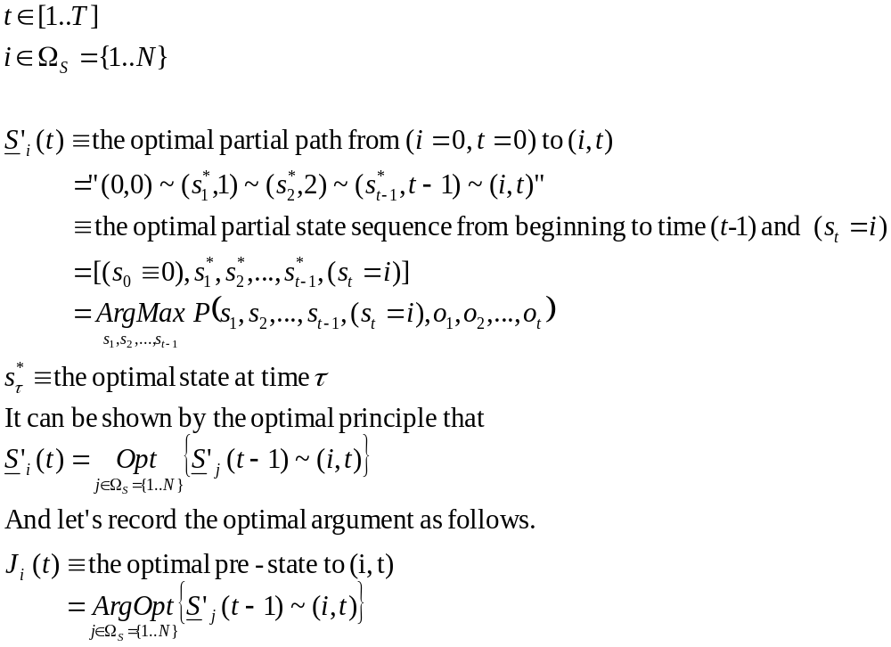
o₁
o₂
o_{t-1}
o_{t}
o_{T-1}
o_{T}
a_{0N}
0
1
2
….
t-1
t
….
T-1
T
T+1
t
0
0
a₀₁
o
S’₁(t-1)
S’₁(t)
a₁₁
M
State 1
b₁(o)
1
1
optimal
J₁ (t)
a_{1N}
a_{N1}
o
S*
a_{NN}
M
State
N
b_{N}(o)
N
S’_{N}(t-1)
1
P(O, S* )
N+1
s₁
s₂
s_{t-1}
s_{t}
s_{T-1}
s_{T}

Slide 47
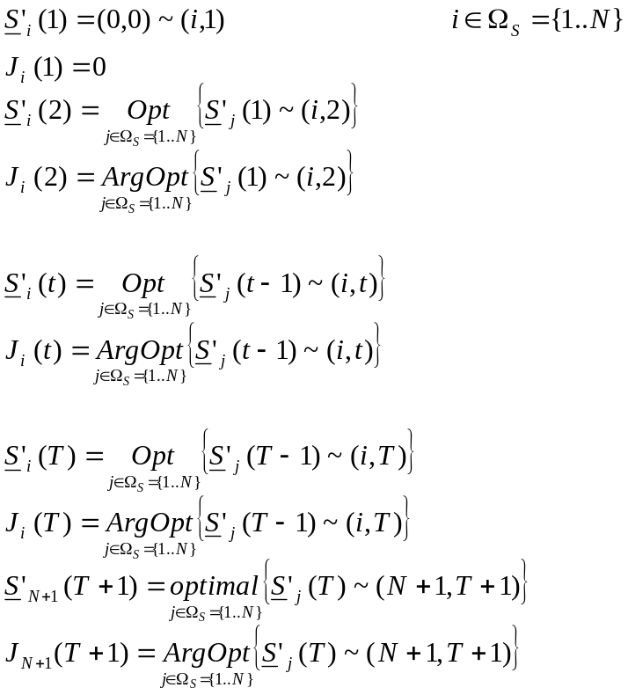
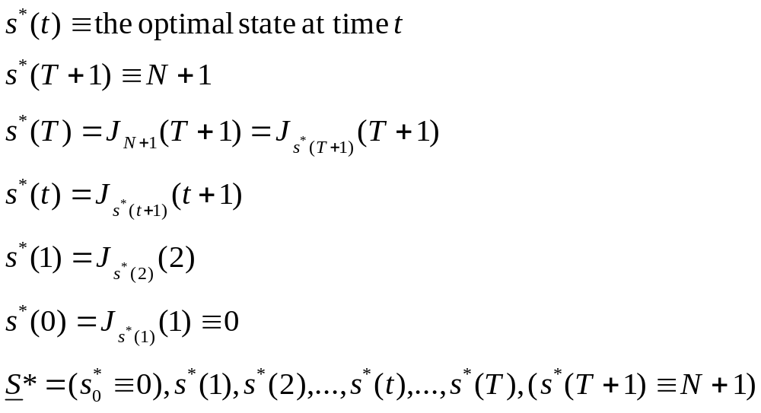
o₁
o₂
o_{t-1}
o_{t}
o_{T-1}
o_{T}
a_{0N}
0
1
2
….
t-1
t
….
T-1
T
T+1
t
0
0
a₀₁
o
J₁ (1)
S’₁(1)
S’₁(t-1)
S’₁(t)
S’₁(T-1)
S’₁(T)
M
J₁ (2)
S’₁(2)
J₁ (T-1)
State 1
b₁(o)
1
J₁ (t-1)
J₁ (t)
1
J₁ (T)
a_{1N}
a_{N1}
o
J_{N} (1)
M
J_{N} (t-1)
J_{N} (T-1)
J_{N} (T)
State
N
b_{N}(o)
N
S’_{N}(1)
J_{N} (2)
S’_{N}(2)
S’_{N}(t-1)
J_{N} (t)
S’_{N}(t)
S’_{N}(T-1)
S’_{N}(T)
J_{N+1} (T+1)
S*
1
S_{N+1} (T+1)
N+1
s₁
s₂
s_{t-1}
s_{t}
s_{T-1}
s_{T}
P(O, S* )

Slide 48
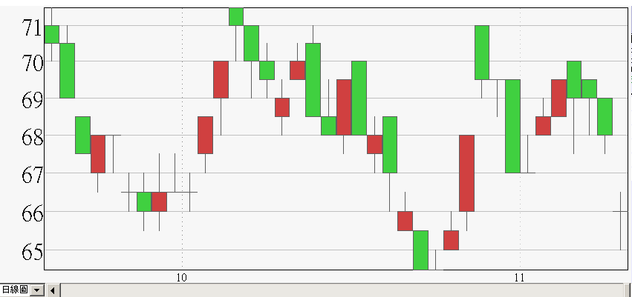
An example application
GGGRFFGRFFRRGGGRRGGRGRGRGFRRGFGFRRGGGF
G: Green, down
R: Red, up
F: Flat, level

Slide 49
The observation sequence
O(t)
GGGRFFGRFFRRGGGRRGGRGRGRGFRRGFGFRRGGGF
A possible state sequence
S(t)
空
頭
市
場
S＝1
多
頭
市
場
S=2
空
頭
市
場
S＝1
多
頭
市
場
S=2
空
頭
市
場
S＝1
多
頭
市
場
S=2
空
頭
市
場
S＝1
 | 空 | 多
空 | 22 | 3 | 25
多 | 3 | 9 | 12
 |  |  | 37
空頭市場
S=1
多頭市場
S=2
 | 空 | 多
G | 15 | 2
R | 6 | 7
F | 5 | 3
 | 26 | 12 | 38

Slide 50
Problems
Provide an initial estimate of {π,A,B}
P(O) =?
The optimal sequence S*=?
Re-estimate {π,A,B} as {π’,A’,B’}
such that P(O| π’,A’,B’) > P(O| π,A,B)

Slide 51

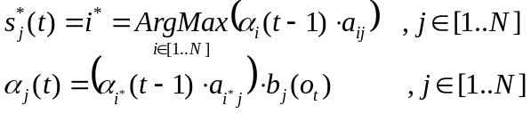

o₁
o₂
o_{t-1}
o_{t}
o_{T-1}
o_{T}
….
….
t
0
1
2
t-1
t
T-1
T
a_{0N}
0
0
a₀₁
α₀(0)=1
a₀₁
o
a_{0N}
a₁₁
M
a₁₁
State 1
a₁₁
a₁₁
1
b₁(o₁)
b₁(o₂)
b₁(o_{t-1})
b₁(o_{t})
b₁(o_{T-1})
b₁(o_{T})
α₁(0)=0
b₁(o)
1
α₁(1)
a_{1N}
α₁(2)
α₁(t-1)
a_{1N}
α₁(t)
α₁(T-1)
a_{1N}
α₁(T)
s*₁(1)
s*₁(2)
s*₁(t-1)
s*₁(t)
s*₁(T-1)
s*₁(T)
a_{1N}
a_{N1}
o
a_{N1}
a_{N1}
a_{N1}
a_{NN}
M
State
N
a_{NN}
N
α_{N}(0)=0
b_{N}(o₁)
a_{NN}
b_{N}(o₂)
b_{N}(o_{t-1})
b_{N}(o_{t})
b_{N}(o_{T-1})
a_{NN}
b_{N}(o_{T})
b_{N}(o)
1
α_{N}(1)
α_{N}(2)
α_{N}(t-1)
α_{N}(t)
α_{N}(T-1)
α_{N}(T)
s*_{N}(1)
s*_{N}(1)
s*_{N}(t-1)
s*_{N}(t)
s*_{N}(T-1)
s*_{N}(T)
N+1
i
s₁
s₂
s_{t-1}
s_{t}
s_{T-1}
s_{T}

Slide 52
Token Passing
a_{N1}
a₀₁
State 1
State
N
0
N+1
a_{0N}
a_{1N}
a₁₁
a_{NN}
α₁(t)
α_{N}(t)
s*₁(t)
s*_{N}(t)

Slide 53
For each state i,
Passing the token of state i to all its connecting state j
a_{N1}
a₀₁
State 1
State
N
0
N+1
a_{0N}
a_{1N}
a₁₁
a_{NN}
For each state j,
Find the best token of all tokens which are passed to state j,
Then update it as the new token of state j
a_{N1}
a₀₁
State 1
State
N
0
N+1
a_{0N}
a_{1N}
a₁₁
a_{NN}

Slide 54
a_{N1}
State 1
State
N
a₀₁
a₁₁
a_{1N}
a_{NN}
N+1
0
N+1
a₀₁
a_{N1}
State 1
State
N
a_{1N}
a₁₁
a_{NN}
這是一個動態的圖，隨著t的前進，
token 會不斷從各個model框框流出，
再進入各個model，
歷經最佳分數選取的機制，再Update目前token後，
繼續流出…

Slide 55
假設根據「文法規則」，model之間可以如下圖連接。

Slide 56
隨著o₁,o₂,…o_{t},…不斷進來，會不斷有token在model間流來流去。
在任意時間點t,這些token會不斷從每個model流出，並流入連接的下一個model，經歷選擇最佳token，並經過model的「消化」後，產生新的token，再流出。
每一個token (at time t, for model w)記載著到時間t為止，

